Slide 1

Présentation du Departement Web

Slide 2

INTRODUCTION
WEB development ‘’
Web development is the process of creating, building, and maintaining websites or web applications. It involves various aspects such as web design, coding, content creation, network security, and database management.

Slide 3
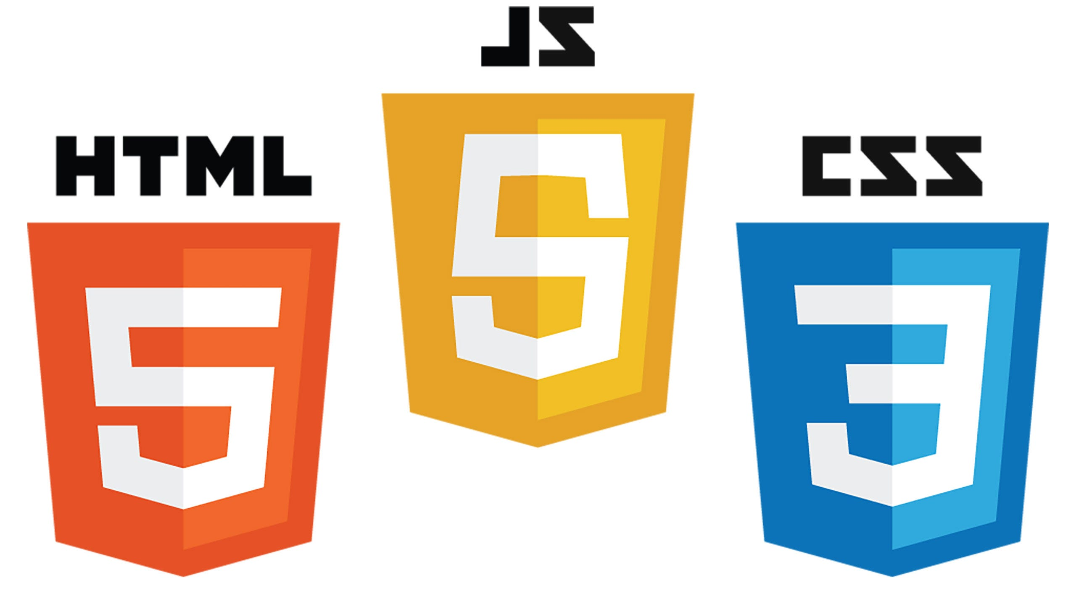
I- Web development typically falls into three main categories:
Front-End Development : This focuses on the part of the website that users interact with directly, such as layout, design, and interactivity. It includes technologies like HTML, CSS, and JavaScript.

Slide 4

I- Web development typically falls into three main categories:
Back-End Development: This is the behind-the-scenes part that powers the front end. It involves server-side programming (using languages like PHP, Python, Ruby, or Node.js), database management (e.g., MySQL, MongoDB), and server configuration.

Slide 5
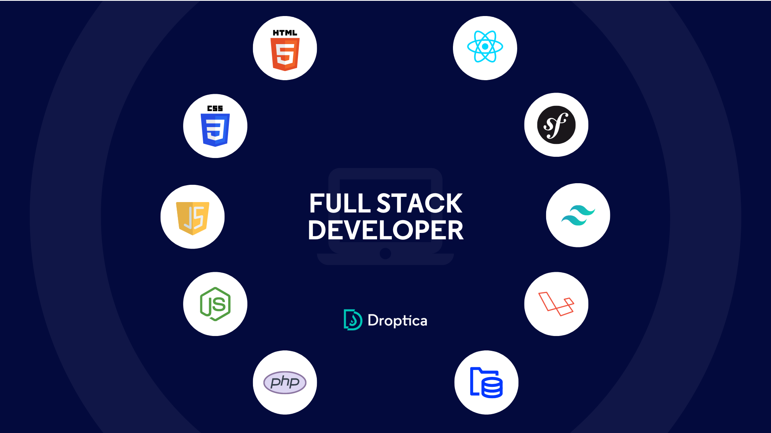
I- Web development typically falls into three main categories:
Full-Stack Development: Full-stack developers work on both the front end and back end, handling both user-facing and server-side tasks.

Slide 6
II- What is a cms all about

Slide 7
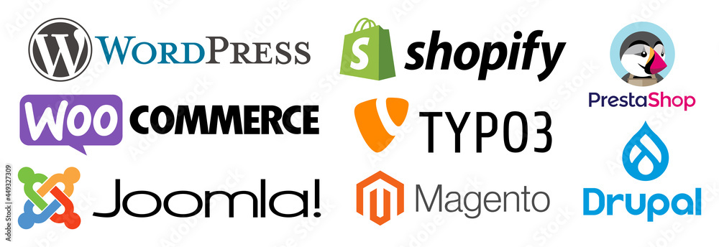

Slide 8
INSERTION DES INFORMATIONS RECU PAR LE CONTACT

Slide 9

MERCI A TOUS

